Slide 1
MANIPULATION OF MATERIALS

Slide 2
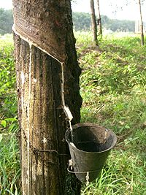
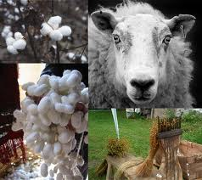
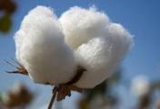
MATERIAL IN ITS NATURAL STATE

Slide 3
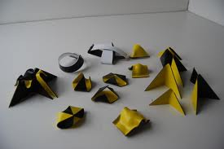
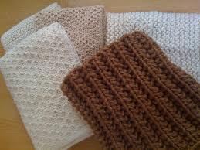
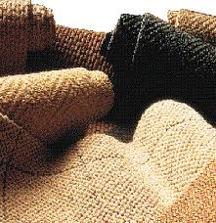
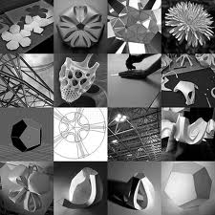
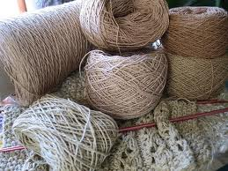
A MATERIAL THAT HAS BEEN MANIPULATED – its composition and structure is not altered

Slide 4
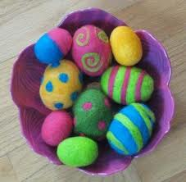
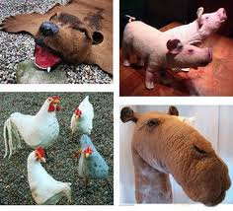
A MATERIAL THAT HAS BEEN TRANSFORMED – new or different properties

Slide 5
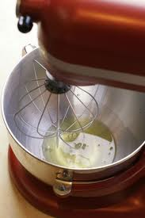
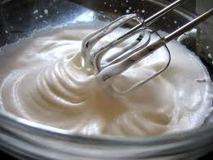
TRANSFORMING -changing the structure of an existing material to change some of its properties but it remains the same material

Slide 6
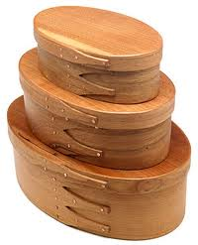
TRANSFORMING MATERIALS
Steaming timber is used to soften
its fibres and allow it to be
Manipulated (bent).

Slide 7
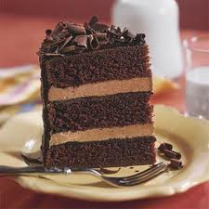
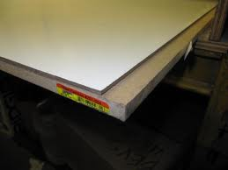
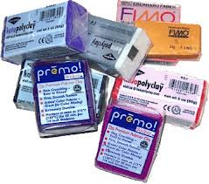
A MATERIAL THAT HAS BEEN FORMULATED

Slide 8
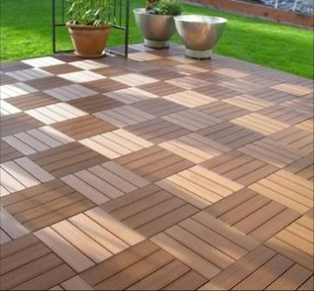
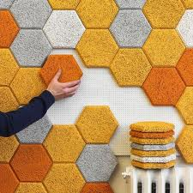
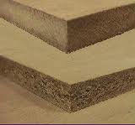
FORMULATED – has had two or more materials added to formulate a new material. This results in a different overall composition and structure than that of the original material.

Slide 9
Manipulation of Materials
Manipulated – the composition and structure of the material has not been altered
Transformed – changing the structure of some of its properties but the material still stays the same.
Formulated – Has had two or more materials added to formulate a new material. This results in a different composition and structure than that that of the original material.

